Slide 1






Ten simple rules to make your teaching more effective
Workshop on
Effective Academic Teaching's
Outcomes
Allegra Via & Vincenza Colonna
Notes:
- Vincenza Colonna
- This is the first ELIXIR-ITA Train the Train activity

Slide 2

EXCELERATE WP11 Train the Trainer (TtT) subtask
develop new courses and materials
new trainers
methodologies, tips and best practices
guidance for course design, development and delivery
Workshop on using VMs and clouds in training
2nd TtT course
Gulbenkian, Portugal
Survey across all ELIXIR nodes:
Training offerings, needs, and capacity
Review workshop
Dec 2015
Jan2016
May2016
July2016
Oct2016
… 2016-19
First TtT course
University of Cambridge
3rd TtT course
CNR, Rome
Workshop to review methodologies and identify effective training approaches
21 TtT pilot events
1/15

Slide 3
Why traditional lecturing fails
Regardless their way of learning, each student receives exact the same information at the exact same pace
2/15

Slide 4
Why traditional lecturing fails
Regardless their way of learning, each student receives exact the same information at the exact same pace
Students respond differently to the same presented material (get it, bored, lost…)
2/15

Slide 5
Why traditional lecturing fails
Regardless their way of learning, each student receives exact the same information at the exact same pace
Students respond differently to the same presented material (get it, bored, lost…)
Students have to listen and take notes → no way to think and make connections
2/15

Slide 6
Why traditional lecturing fails
Regardless their way of learning, each student receives exact the same information at the exact same pace
Students respond differently to the same presented material (get it, bored, lost…)
Students have to listen and take notes → no way to think and make connections
The teacher is busy in transferring content → no time for other activities
2/15

Slide 7


3/15
Learning by doing/non formal learning

Slide 8
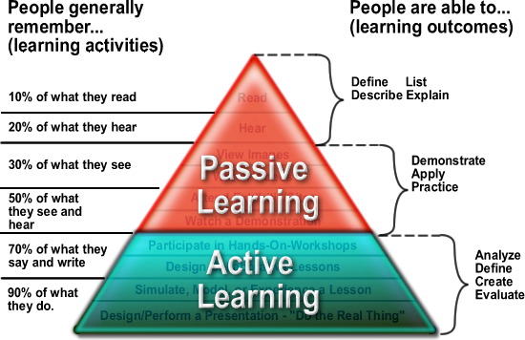
4/15

Slide 9
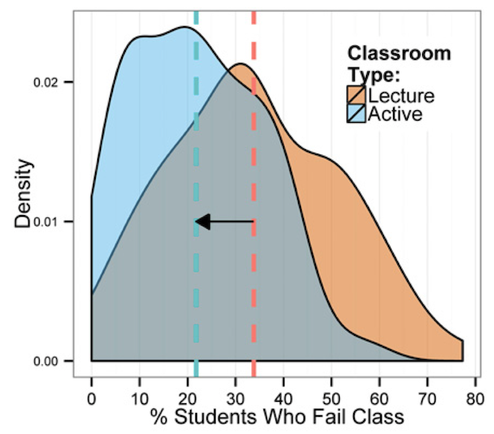
Active learning cut course failure rates by around one-third
Analysis of 225 studies of active learning in science, technology,
engineering and mathematics
Freeman et al. PNAS (2014) Active learning increases student performance in science, engineering, and mathematics.
5/15

Slide 10

"AT THIS POINT IT IS UNETHICAL TO TEACH ANY OTHE& WAY" *
*Clarissa Dirks, co-chair of the US National Academies Scientific Teaching Alliance, an initiative to reform undergraduate STEM education
"Students gain a much deeper understanding of science when they actively grapple with
questions than when they passively listen to answers"
Waldrop, Nature 2015
6/15

Slide 11

What changes?
Teacher lecturing (partially) replaced by students’ activities
student-centred/individual interactions
maximise interactivity among students and with the teacher
role of the teacher: sage on the stage → guide on the side
7/15

Slide 12
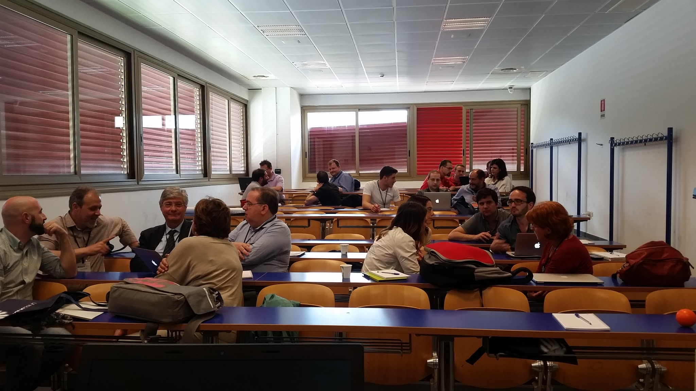
Group work: what can we do to promote active learning in university courses?
A. Cestaro, S. Tosatto, N. D’Agostino, M. Gebiola
B. Hay Mele, ML Chiusano, D.Palumbo, R. Marangoni
L. Milanesi, P. Fernandes, B. Fosso, R. Percudani, D. D’Elia
F. Zambelli, G. Iacomino, D. Parisi
F. Musacchia, C. Angelini, F.Chiappori, N. Cancrini, G. Spinozzi
8/15
Notes:
- In the workshop we descried principles and approaches that have been proved to dramatically improve the quality of teaching
- Participants were then grouped to discuss how these principles could be implemented in academic teaching
- Ideas and suggestions were written in a Google doc
- We extracted rules

Slide 13
> Ten simple rules to make your teaching more effective
Workshop on
Effective Academic Teaching's
Outcomes

Slide 14
Course/lesson preparation
Set clear goals/learning objectives (also based on number and type of students)
9/15

Slide 15
Course/lesson preparation
Set clear goals/learning objectives (also based on number and type of students)
Prepare questionnaires (collect students info)
9/15

Slide 16
Course/lesson preparation
Set clear goals/learning objectives (also based on number and type of students)
Prepare questionnaires (collect students info)
Develop/choose (excellent*) materials (books, videos, slides, notes, podcast)
Make them available
*appropriate/stimulating/interesting
9/15

Slide 17
Course/lesson preparation
Set clear goals/learning objectives (also based on number and type of students)
Prepare questionnaires (collect students info)
Develop/choose (excellent*) materials (books, videos, slides, notes, podcast)
Make them available
Let students choose part of the course's topics
*appropriate/stimulating/interesting
9/15

Slide 18
Course/lesson preparation
Set clear goals/learning objectives (also based on number and type of students)
Prepare questionnaires (collect students info)
Develop/choose (excellent*) materials (books, videos, slides, notes, podcast)
Make them available
Let students choose part of the course's topics
Prepare "real-life" projects
*appropriate/stimulating/interesting
9/15

Slide 19
Course/lesson delivery
Clearly describe goals/learning objectives
10/15

Slide 20
Course/lesson delivery
Clearly describe goals/learning objectives
Use questionnaires (google forms) - Formative assessment
10/15

Slide 21
Course/lesson delivery
Clearly describe goals/learning objectives
Use questionnaires (google forms) - Formative assessment
Initial lesson(s): fill the gaps and level students out
10/15

Slide 22
Course/lesson delivery
Clearly describe goals/learning objectives
Use questionnaires (google forms) - Formative assessment
Initial lesson(s): fill the gaps and level students out
Heterogeneous groups for discussion, problem solving, carrying out "real-life" projects
10/15

Slide 23
Course/lesson delivery
Clearly describe goals/learning objectives
Use questionnaires (google forms) - Formative assessment
Initial lesson(s): fill the gaps and level students out
Heterogeneous groups for discussion, problem solving, carrying out "real-life" projects
Divide topics in subtopics and assign them to groups. The teacher may eventually connect all the parts
10/15

Slide 24
Course/lesson delivery
Students introduce and recap topics and present project results (points can be included in the students’ overall grade)
11/15

Slide 25
Course/lesson delivery
Students introduce and recap topics and present project results (points can be included in the students’ overall grade)
The teacher can use the recap to expand concepts/topics
11/15

Slide 26
Course/lesson delivery
Students introduce and recap topics and present project results (points can be included in the students’ overall grade)
The teacher can use the recap to expand concepts/topics
Use training techniques to promote interactivity and involvement (games, competitions, rewards)
11/15

Slide 27
Course/lesson delivery
Students introduce and recap topics and present project results (points can be included in the students’ overall grade)
The teacher can use the recap to expand concepts/topics
Use training techniques to promote interactivity and involvement (games, competitions, rewards)
Teachers should be allowed to change topic every few years
11/15

Slide 28
Post-course/lesson
Use (also) self-evaluation
12/15

Slide 29
Post-course/lesson
Use (also) self-evaluation
Give extra points for extra activities
12/15

Slide 30
Post-course/lesson
Use (also) self-evaluation
Give extra points for extra activities
Promote eCommunication (facebook, etc) with/without teacher
12/15

Slide 31
Post-course/lesson
Use (also) self-evaluation
Give extra points for extra activities
Promote eCommunication (facebook, etc) with/without teacher
Stimulate students to attend the exams of their classmates
12/15

Slide 32
Post-course/lesson
Use (also) self-evaluation
Give extra points for extra activities
Promote eCommunication (facebook, etc) with/without teacher
Stimulate students to attend the exams of their classmates
Share active learning principles with colleagues in the department/area to induce a change at the system level
12/15

Slide 33
Conclusions I
Many more active learning techniques than we thought can be transferred from non formal to formal learning
Key points:
Be aware of diverse student motivation
Find ways to reward students
It takes a lot of work: start simple
13/15

Slide 34
Conclusions II
We asked workshop participants to commit to introduce some active learning techniques in their courses in the next semester
We will collect their thoughts at the end of semesters
Present the results @ BITS2017??
14/15

Slide 35
Special thanks to
Anna Marabotti
Pedro Fernandes (ELIXIR-PT TrC)
All the workshop participants
BITS
Friday, 17th - 14.00-15.30
Round table on
Current needs in Europe for bioinformatics professionals: what it is and what should be taught in BSc and MSc courses in Italy?
15/15

Slide 37
Goals of ELIXIR-ITA Training
Develop a
programme/infrastructure
for bioinformatics training
Visibility of ELIXIR-ITA in Europe and beyond
Support and strengthen research in bioinformatics
Train qualified instructors

Slide 38

Courses 2015
Gene Expression profiling with HTS: RNA-Seq data analysis – CINECA Rome - 19-22 October 2015
Protein Networks and Systems Biology, Università di Bologna, 14-18 December 2015
High Throughput Sequencing (HTS) data analysis – Sapienza Università - 5-7 October 2015
NGS for evolutionary biologists: from basic scripting to variant calling – CINECA Rome - 23-27 November 2015
http://bioinformaticstraining.pythonanywhere.com
elixir.ita.training@gmail.com

Slide 39
Metagenomics data processing and analysis
Courses 2016
Biomedical data analysis, interpretation and representation
Rome, December
High Performance Molecular Dynamics@CINECA - PRACE Edition
CINECA, Bologna - 20-30 September
Exome analysis using Galaxy
Milano Bicocca, 19-20 Sept
Effective academic teaching
University of Salerno, Fisciano (SA), Italy - June 15th,
RNA-seq data analysis
University of Naples Federico II, Naples - June 6-10
NGS for evolutionary biologists: from basic scripting to variant calling
CNR, Naples - May 2-6
Analyse your data using Python
University of Bari, 26-30 Sept
Metagenomics data processing and analysis Bari, November
http://bioinformaticstraining.pythonanywhere.com
elixir.ita.training@gmail.com

